Slide 1
Primary and Secondary Caregiver clarification
10-10 Health Apps Team
Presenter Name
Heather Justice | heather.justice@adhocteam.us
December 15, 2021

Slide 2
Caregivers of Veterans have a program!
Notes:
My team works on the 10-10CG, also known as the Program of Comprehensive Assistance for Family Caregivers

Slide 3
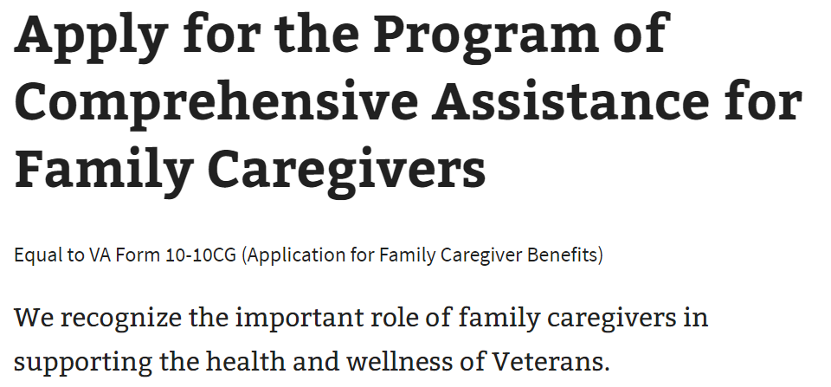

What is this?
Veterans and their Caregivers can apply for this program that will provide support, services and education for Caregivers to better care for their Veterans.
There can be one Primary Caregiver and two Secondary Caregivers.
Notes:
This program provides support, services and education for Caregivers so they can provide better care for their Veterans
There can only be 1 Primary and 2 secondary CGs designated at a time.

Slide 4
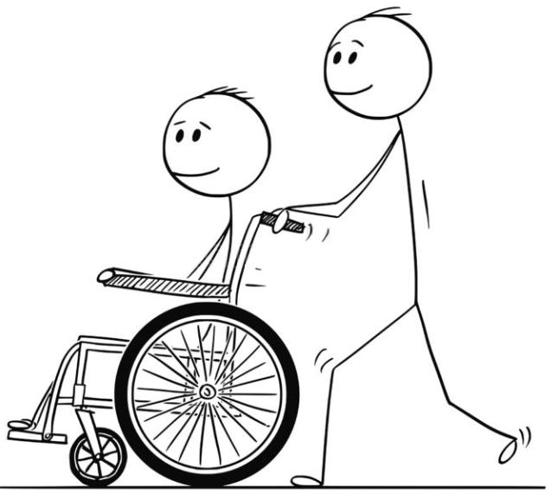

What is the difference?
A Primary Family Caregiver is an individual designated as primary provider of personal care services for the Veteran.
A Secondary Family Caregiver is an individual approved as a provider of personal care services for the Veteran and generally serves as a back-up to the Primary Family Caregiver.
There is no difference in responsibilities!
Notes:
While both roles are described as providers of personal care services for the Veteran, they are exactly as you would think. Primary takes point, while the Secondary is a backup in case the Primary needs assistance.

Slide 5
Here’s the difference!
Primary caregivers receive:
A monthly stipend (paid directly to the caregiver.)
Access to health care insurance through Civilian Health and Medical Program of the Department of Veterans Affairs (CHAMPVA), if the caregiver does not already have health insurance.
Mental health counseling.
Certain beneficiary travel benefits when traveling with the Veteran to appointments.
At least 30 days of respite care per year, for the Veteran.
Respite care is a paid program that provides short term relief for someone else to care for the Veteran while the Primary caregiver takes a break.
Secondary caregivers receive:
Mental health counseling.
Certain beneficiary travel benefits when traveling with the Veteran to appointments.
Notes:
The main difference between them is the benefits they can receive.
The Primary can receive a monthly stipend, access to health care insurance thru CHAMPVA, mental health counseling, Beneficiary travel benefits such as reimbursement for transportation and lodging, and 30 days per year to take a break, with access to a Respite care program for those Veterans who do not have Secondary caregivers.
The Secondary caregiver benefits include mental health counseling and beneficiary travel benefits. Since the Secondary would only step in when needed, they are not eligible for the other benefits.
This is great, right? Pretty easy to understand, so applying shouldn’t be an issue.

Slide 6
What? There’s a problem?
Notes:
But wait, what? Now we are hearing there is a problem..

Slide 7
What’s the problem?
Veterans and their Caregivers are confused about the difference between a Primary and Secondary Caregivers, and about the process of including them while completing the application.
This confusion is causing:
Application abandonment
Complaints on the form itself
Duplicate data resulting in duplicative efforts for both Caregiver Support Centers and Veterans
A decrease in applications submitted successfully
Resulting in Caregivers not receiving the support and services they need.
Notes:
The problem is, people don’t understand.. Or at least while they are in our application, they don’t have all the information readily available to make the right decisions in the moment.
So when they dont have the information, the applicants get confused and frustrated, causing abandonment and negative feedback.
A recently discovered underlying problem is that when a Veteran wants to change or add a Caregiver, they have to fill out the same form. The catch is, they can’t include duplicate information, meaning if the Veteran is adding a secondary CG, they can only enter their own information and the new CG information. If they include the existing primary CG information too, this causes duplicate information and cannot be accepted.
(reasons they may include the Primary CG info: for good measure, because they think they need to, because there are no instructions to state otherwise)
All this contributes to applications not being submitted properly, decrease of trust in VA and ultimately resulting in Caregivers not getting the support they need.

Slide 8

How did we find out?
Research Studies
In unrelated research studies conducted in early 2021 and early 2022, a few participants mentioned that they did not understand the difference between Primary and Secondary caregivers, the roles they have in caring for the Veteran, or the benefits they receive.
Notes:
How did we find out there was a problem?
Over the last 2 years, there were research studies conducted on the form for other features, and a common theme emerged around the difference between the roles, and how it is being presented in the form.

Slide 9
Maybe if there is a way to have primary and secondary together to explain the differences so I know right off the bat what I'm applying for.
— Research study participant
Notes:
A quote from one of the participants

Slide 10

How did we find out?
Stakeholders
Feedback from Caregiver support centers stating that applicants call in with confusion and frustration
When errors in adding or changing Caregivers result in duplicate data, Veterans are contacted and often times asked to re-apply!!!!
Notes:
We also received feedback from the Caregiver support centers describing conversations on the same theme, confusion and frustration in not understanding the difference and how to complete the form
Remember the scenario of adding a secondary caregiver and including the existing primary caregiver info on the form causing duplicate info?
Well, when the CG Support centers receive those applications that have duplicate information compared to existing data, this causes additional reviews, contacting the Veteran and (most of the time) asking them to reapply without the Primary CG info on the form!
What a horrible experience…

Slide 11



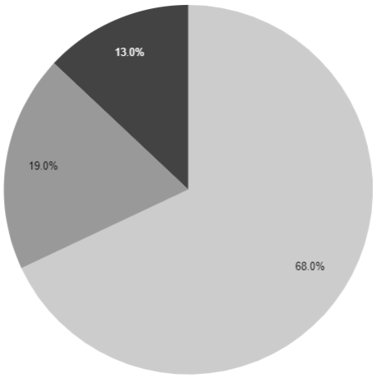
How did we find out?
When eligibility for Veterans was expanded in October, the submitted applications doubled, and so did the drop-offs!!
31% of the applications, which start the Secondary Caregiver section, exit before they submit. That’s about 550 applications a month!
That exit rate makes up about 12-13% of total applications started.
Notes:
After learning about the feedback and terrible duplicative process, we pulled some numbers.
The overall average abandonment rate for the 10-10CG is 32% over 5 months, compared to 23% for the 10-10EZ.
We see a significant exit rate within the first Secondary Caregiver section, between the Identification (name, address) and the Contact info (Phone, email) pages. - They say Yes to secondary, complete the Name & Address page, continue to Phone/email page and leave the application
There is a monthly average of 550+ applications (31%) that start the Secondary Caregiver section, but then exit the application. (1900 start the section, and 550 exit the form - monthly)
This exit rate makes up about 12-13% of total applications started.
This is important because
There is a potential to impact ~1,000 Veterans and their caregivers monthly, based on 1,300 average applications that include Secondary Caregivers, over a 5 month period.
Eligibility was expanded October 1, 2022 to include Military Service from all eras. This doubled the number of submitted applications. The number of applications with Secondary Caregivers more than doubled from 1,186 applications in September to 2,343 applications in October.

Slide 12
What does the form look like now?

Slide 13
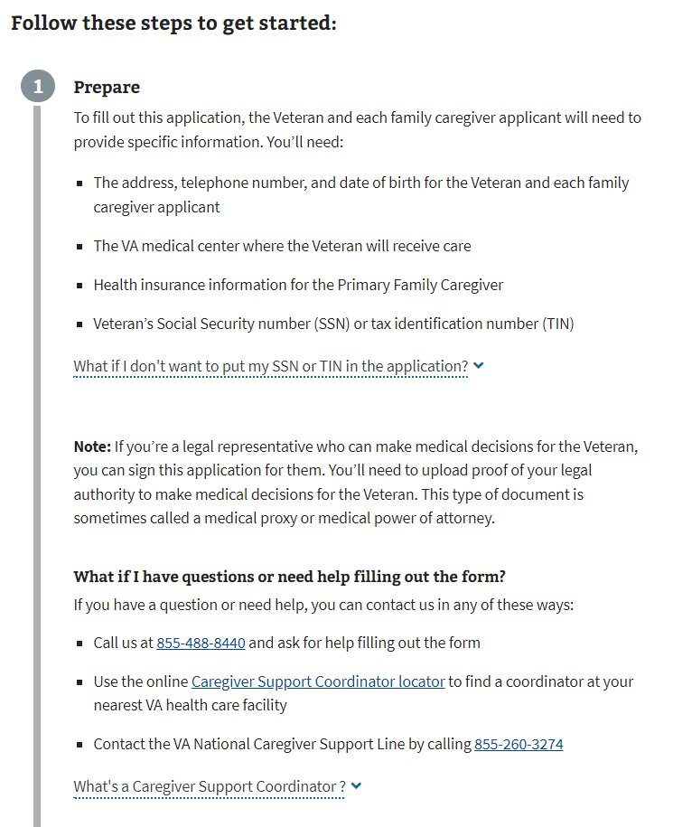
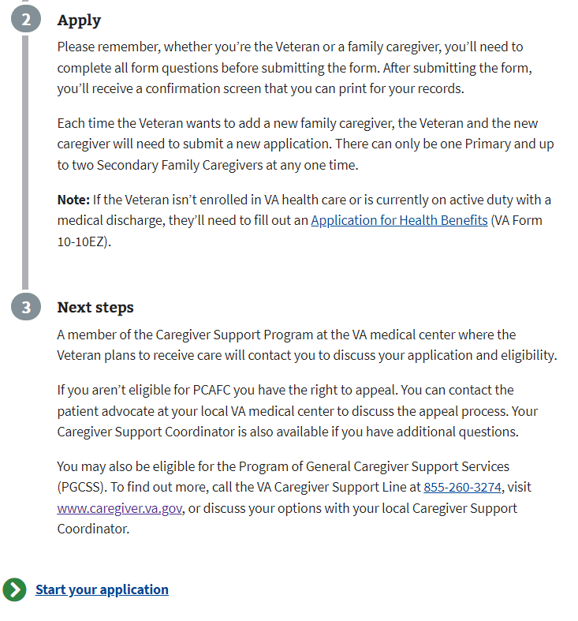
Introduction page
Things to know
What is needed
Support
More Info
Notes:
Here is our intro page. We include a list of pertinent information that will needed, a note about legal documents like POA to sign for the Veteran, resources if you need help, a few tips on applying and what is expected next, with a link to the CG info page to learn more.
What we don’t have here is any information about the CG roles, responsibilities or benefits. We provide links to other pages that do provide this information (followed by one or two other link clicks on those pages).

Slide 14
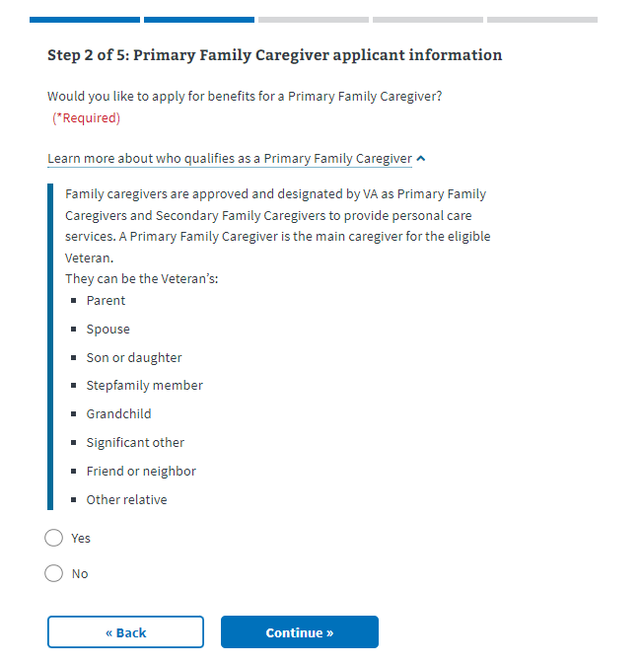
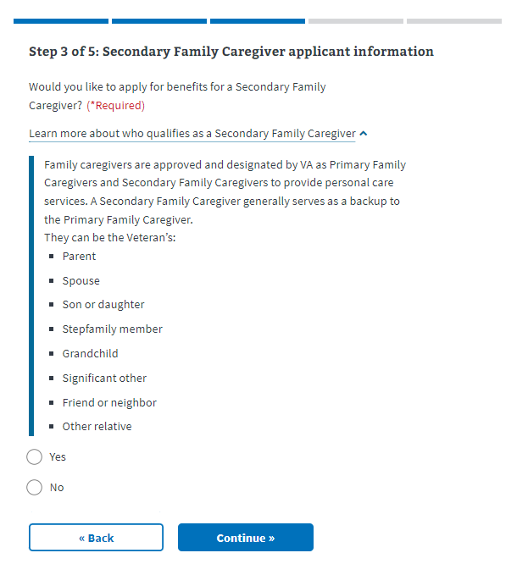
First pages leading to Caregiver data pages
There is nothing here about the responsibilities or benefits either!
Notes:
Within our form, on the starting pages for each Caregiver role, we list information about who qualifies, but there isn’t anything here about the responsibilities or benefits.
There has to be a way to efficiently and effectively include the details in this form, without overwhelming the applicant or causing more confusion.

Slide 15
What kind of change do we think will benefit our applicants?
Notes:
So how do we think we will be able to improve the experience?

Slide 16

Let’s be crystal clear
Clarify the roles and benefits of the Primary and Secondary caregivers
Position this information upfront and within the 10-10CG form-Caregiver data pages
Clarify the steps and information needed when changing or adding new Caregivers
Notes:
We want to make the information crystal clear, plain and easy to understand.
We want to position the information in the places where the applicants will expect to see it.

Slide 17
Assumptions..
you know what they say

Slide 18

If we are right…
The changes will make it easy to understand the roles and responsibilities of the Primary and Secondary Caregivers, leading to easier decisions
Veterans and Caregivers will be confident in completing and submitting the application
Notes:
If we are right, these changes are going to make the information readily available and easy to understand, leading to easier decisions and confidence in completing the form

Slide 19

If we are wrong…
Our changes will not clarify the roles sufficiently, and applicants will continue to exit the application when entering the Secondary Caregiver information
Applicants will continue to be confused, leading to continued inaccuracy or duplicative information; resulting in rework and re-applications
Applicants will be overwhelmed by the information displayed and will not read it, leading to continued inaccuracy or duplicative information.
Notes:
But if we are wrong, applicants will continue to be confused, or it will make matters worse. This is why we need to be very careful in our language, and test it out with Veterans across a wide range of demographics and usability skills

Slide 20
How will we measure the effect of our changes?

Slide 21

How will we know?
Veterans and their Caregivers can quickly and easily submit the application in a single session, while confidently listing the Caregivers in their intended hierarchy
Reduce Application Abandonment, specifically within the Secondary Caregiver section
Reduce duplicate data submissions
Pending exact data from CG Stakeholders
Anecdotal evidence suggests the process is “burdensome”
Reduce the number of sessions it takes to complete the application
Current monthly average of 3,500 applications are completed in one session
Current monthly average of 1,300 applications are completed in more than one session
Notes:
Reduce Application Abandonment, specifically within the Secondary Caregiver section
Reduce duplicate data submissions, which will reduce rework by Caregiver Support representatives and re-applications by Veterans and Caregivers
Reduce the number of sessions it takes to complete the application

Slide 22

How else will we know?
Veterans and Caregivers will feel satisfied, and trust that VA is committed to Veterans.
Highlights from 2022 Medallia Survey results:
273 out of 364 respondents were able to complete their task that day
89 out of 124 respondents reported a moderate to high level of Satisfaction with VA.gov
22 out of 31 respondents reported a moderate to high level of Trust in VA Commitment to Veterans
Notes:
Reducing abandonments and duplicative efforts is great, and will definitely tell us that the application seems easier to understand and complete. We also want to create an impact overall, we want Veterans and Caregivers to go through this form with ease, and help bolster their feelings about VA and VA.gov. We want them to think “Since this application was easy, what else can I do with VA? What else is out there for me?” – We all want them to find out!
All survey feedback provided came from within any page of the Caregiver application.
There were 464 total survey responses, not all responses got answers
49 A11 surveys
415 VFS surveys
273 out of 364 (75%) responses completed their task (66% out of 415)
22 out of 31 responses (71%) were a 4 or 5 on Trust in VA Commitment (45% out of 49)
89 out of 124 responses (72%) were a 4 or 5 on Satisfaction with VA.gov ( 21% out of 415)

Slide 23

The End
Notes:
This is the last slide.

Slide 24
Questions?
Notes:
Steps, walk the applicant through the process
Tool TIps (Accessibility??)
Leverage ‘sections’ - present in chunks as proceeding
Clarify when adding/changing - different path? - weird that we dont have instructions here!

